Slide 1
Strings in C
Revision

Slide 2
Character Strings in C
String: An array of characters
String is an important data structure because computers are used for word processing applications such as creating, inserting, modifying textual data
Each string is terminated by a null character denoted by escape sequence ‘\0’ which indicates end of the string
char s[] = “hello”;
When the compiler encounters a sequence of characters enclosed in the double quotation marks, it appends a null character \0 at the end by default.
In above example, a character array of size 6 is created where the lower bound of array is 0 and upper bound is 5.
A null character is automatically appended to the end of the string
Char s[10] = “hello”; an array of size 10 is created where last five spaces are initialized by null character.

Slide 3
Another way of creating a string:
char s[] = {'H', 'e', 'l', 'l', 'o', '\0'};
The difference between the two ways of creating strings is:
The first method is easier to write and we do not have to include the \0 character explicitly.
In the second method we have to include null character at the end explicitly.
Examine these:
char greetings[] = {'H', 'e', 'l', 'l', 'o', ' ', 'W', 'o', 'r', 'l', 'd', '!', '\0'};
char greetings2[] = "Hello World!"; printf("%d\n", sizeof(greetings)); printf("%d\n", sizeof(greetings2));
The size of both arrays is same and both have 13 characters (adding space that also counts as a character and the \0 character)
Note: char s[5]= “hello”; in this case null character will not be appended automatically.
Hence, when we declare a string like char str[100] then we can store maximum 99 characters

Slide 4
Declaring, initializing and assigning a string
char c[20]; (declare)
Initializing a string:
char c[] = "abcd";
char c[50] = "abcd";
char c[] = {'a', 'b', 'c', 'd', '\0'};
char c[5] = {'a', 'b', 'c', 'd', '\0'};
Assigning a value to string:
char c[100];
c = "C programming"; {Error, once an array is declared, can not assign value to it like this, We have to assign values through for loop}
Note: At the time of Initialization we can do like this.

Slide 5
Reading the strings
char mystring[10]; It can be read as:
Using scanf() function: scanf(“%s”,mystring)(does not require & like int, float and char values)
scanf() terminates as soon as it gets a blank space
Using gets() function;
gets(mystring);
It overcomes the drawback of scanf. It takes the initial address of string and reads till the null character or end of line.
Using getchar(), getch() functions repeatedly
i = 0;ch = getchar(); while(ch!=‘*’) (mystring[i] = ch; ch = getchar();i++;} str[i] = ‘\0’;

Slide 6
Writing Strings
Strings can be displayed on the screen in three ways:
printf() 2. puts() 3. putchar()
char greetings[] = "Hello World!";
printf("%s", greetings); printf("%c", greetings[0]);
printf("%c", greetings[4]);
Note: We can also specify the width of output field
Using puts() function; It is a simple function. It terminates the line with a newline character ‘\n’;
Using putchar() function repeatedly
i = 0;while(ch[i] !=‘*’) (putchar(ch[i]); i++;};

Slide 7
Read and write strings
#include <stdio.h>
#include <string.h>
int main() {
char name[20];
printf("Enter the name:");
scanf("%s", name);
printf("%s",name);
return 0; }
Things to note: & sign is not used when reading strings; scanf reads the string till it gets a space character. Check the output for different types of names.

Slide 8
Using puts and gets functions..
#include <stdio.h>
#include <string.h>
int main()
{ char nickname[20];
puts("Enter your Nick name:");
gets(nickname);
puts(nickname);
return 0;
}
Note: %s is not required in puts and gets

Slide 9
Some common operations on strings (implement in the lab)
Finding the length of a string
Converting characters of string into upper case
Concatenating two strings to form a new string
Appending strings
Comparing strings
Reversing a string
Extracting a substring from the left of a string
Extracting a string from the right of a string
Extracting a substring from the middle of a string

Slide 10
Finding the length of a string
int main()
{ char str[20]; int i=0, length;
printf(“\n enter the string:”);
gets(str);
while (str[i]!=‘\0’) i++;
length = i;printf(“\n length = %d\n”, length)
return 0;
}

Slide 11
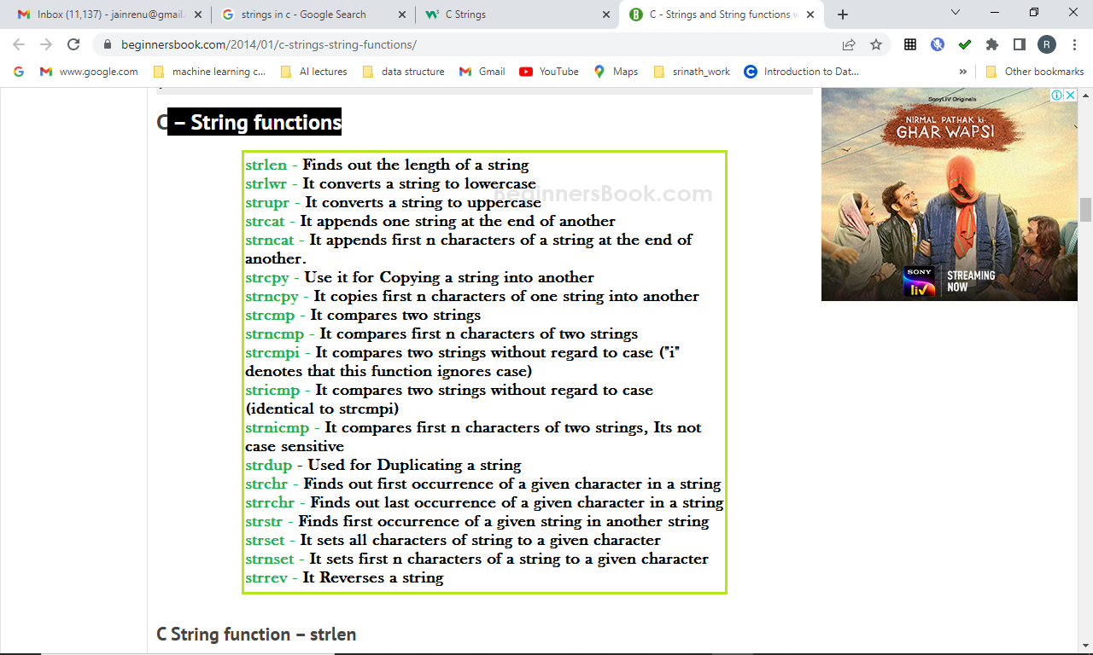
String functions

Slide 12
Array of strings
If we have to store names of 10 students then we have to declare an array of strings.
String is an array of characters.
Hence an array of array of characters (two dim array)
char name [10][20];
Equivalent to 10 variables of name: where each has maximum size 20
Or there are 10 strings of size 20
name[0], name[1], name[2]……………..name[9]

Slide 13
Cont..
char name [5][10] = {“ram”,”mohan”,”sita”, Shyam, “Rakesh”};

Slide 14
Sample program
#include <stdio.h>
void read_names(char s_name[5][10],int n)
{int i; for (i=0;i<n;i++)
{printf("enter %d student name\n",i);
gets(s_name[i]);
puts(s_name[i]); }
}
void main()
{ int n; char names[5][10]; n =5; read_names(names,n);
printf("second name = %s\n",names[1]); }

Slide 15
Pointers and Strings
String is an array of characters
So the concept of pointers is same as in the case of ordinary arrays

Slide 16
Class and lab exercise
Write a function that reverses the character string s.
char * reverse(char *s)
{int k,i;
Int l = len(s);
char rev[l];
for (i=0,k = s[l-1]; i<l;k==0; i++,k--) rev[i] = s[k];
rev[l] =‘\0’;

Slide 17
More on Strings in C..
There are two ways to store string:
char p[20] or a pointer pointing to a string char* s = “abacdef” and both can be accessed as arrays.
But, following are the key differences:
The operator sizeof(p) will give the memory allocated to character array.
sizeof(s) will give size of pointer which is independent of the string pointed by s.
Each string is appended by a null character (‘\0’) which indicates the end of the string.
The length of string can be calculated using strlen() function.
But, the function does not include null character ‘\0’ in the length. .
p is a character array, its individual elements can be modified (p[i] = ‘c’).
As s is a pointer, it can be pointed to any other string as well (s =”string2”). However, using p, it is not possible.

Slide 18
Que – 1. What does the following fragment of C-program print?
char c[] = "GEEK2018"; char *p =c; printf("%c,%c", *p,*(p+p[3]-p[1]));
(A) G, 1
(B) G, K
(C) GEEK2018
(D) None of the above

Slide 19
#include<stdio.h>
#include<string.h>
void main()
{char p[10] = "hello";
char * s = "string";
printf("length of p %lu length of s %lu\n",strlen(p),strlen(s));
p[3] ='L';
//s[3] = 'L';not allowed
printf(" p %c s %c\n",p[2],s[4]);
}

Slide 20
#include<stdio.h>
#include<string.h>
#include<stdlib.h>
void main()
{char p[10] = "hello";
char * s = "string";
char *news = "newstring";
news = (char*) malloc(10*sizeof(char));
news[6] = '5';
printf("length of p %lu length of s %lu\n",strlen(p),strlen(s));
p[3] ='L';
//s[3] = 'L';not allowed
printf(" p %c s %c %c \n",p[2],s[4], news[6]);

